Slide 1
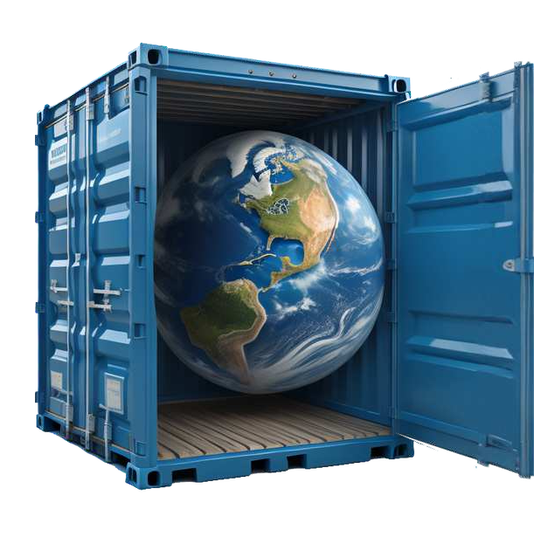
Your personalised & worldwide freight
consultant for the Pacific Islands
Contact
New Zealand Office
Telephone: +64 9 972 0460
16/203 Kirkbride Road, Auckland 2150 New Zealand
Tahiti Office
Telephone : +689 40 42 99 60
15 rue du Dr Cassiau B.P. 44361 Papeete Tahiti French Polynesia
Web site
https://www.worldcargopacific.com

Slide 2
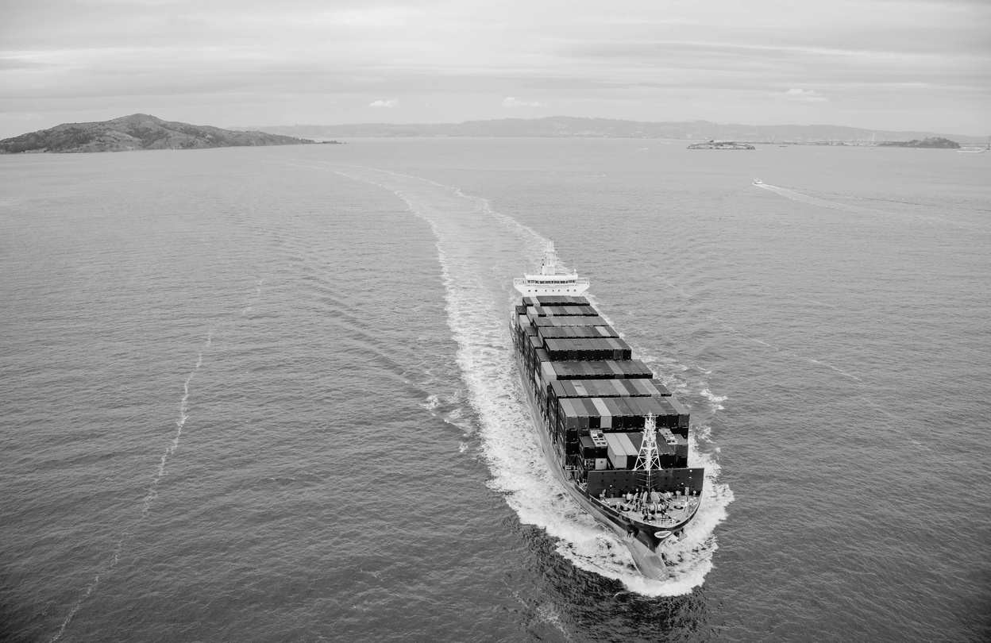
COMPANY
PACIFIC SPECIALIST
Specialising in Consolidation services INTERNATIONAL FREIGHT FORWARDING SERVICES
World Cargo Pacific (WCP) is your personalised and worldwide freight consultant into the Pacific Islands.
We are a young, and dynamic company offering a personalised and professional service in international freight forwarding.
Specialising in Consolidation services worldwide into the Pacific Islands as a niche market; while at the same time, we handle any cross trade shipment worldwide and to/from New Zealand.
WORLD CARGO PACIFIC STRENGHTS
Regular up-dates on Tracking & order follow-up
Fast reply turn around Attention to details
Imports & Exports Groupage /
Seafreight Airfreight Consolidation Pacific Specialist
Consolidation Specialist
Worldwide Hubs for Groupage Services to PAPEETE, NOUMEA, & PORT VILA
Personalised Services to requirement for our Pacific
suit Islands
customers - CUSTOMER CENTRIC VISION
Strong knowledge and experience for all Pacific Islands
IT Customised Solutions to improve
efficiencies and effectiveness Integration of Services for Logistics Solutions
Effective

Slide 3
WCP GLOBAL
Offer value-oriented solutions
World Cargo Pacific is unique in our approach to worldwide operations and coverage. WCP GLOBAL is your "Worldwide Consol/Groupage Hub solution partner". Specialising in LCL Imports and Exports Consolidation/Groupage Service to and from New Zealand with the World.
WCP have built a network of competent, experienced, responsible, trustworthy, agile and competitive partners who are the extension of WCP.
Our global partners each specialize in certain areas of supply chain, logistics and freight forwarding. They each have their strengths to secure space with ocean and air carriers, develop in-country warehousing and distribution, secure the right truckers, develop IT and Track/Trace systems, and clear customs.
Our global reach gives our customers piece of mind that their shipments, whether heavy lift/project cargo, ocean freight, air freight, trucking or warehousing, or a combination of these modes, will be taken care of from A-Z.
We have built these partnerships over years of business together, meeting them face to face, understanding each other’s strengths and professional certifications, and developing and implementing operations that sync with our customer’s demands.
Technology Strategy
WCP invest in Technology Strategy for keeping rapid flow of information to move freight smoothly, and to communicate in real time with our customers.
WCP Tracking
WCP keep your business moving On Time and On Track in order to communicate information flow of your cargo; and thus maintaining a high level of service.
24 x 7 support
Competitive edge for Efficient Shipping Services. 24 x 7 support services are available for our clients to obtain on time up-dates of information and promt response.

Slide 4
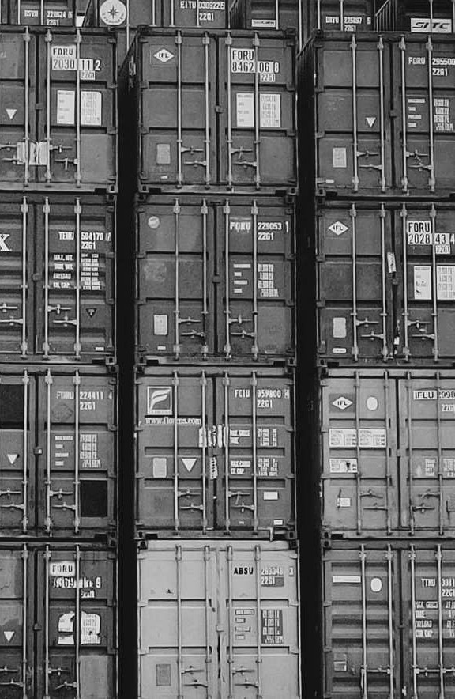
TECHNOLOGY USED
At World Cargo Pacific, we understand the importance of technology; an accurate and rapid flow of information is a critical requirement to ensure the smooth and predictable movement of freight. At the center of our technology strategy is the world’s leading logistics solution, CargoWise One from WiseTech Global.
The CargoWise One system is a complete global freight solution to manage bookings, local cartage, transport, shipping, customs, warehousing and more. World Cargo Pacific exchanges data in real time with our agents, customers and other partners, enabling us to provide the very highest level of service.
Combining with our state-of-the-art WCP PORTAL platform, we are able to offer an unparalleled level of service in the freight forwarding industry.
Our cutting-edge Tracking system grants our valued customers unrestricted, round-the-clock access to both Air and Sea freight information, enabling real-time transparency into the intricacies of their supply chain.
At WCP, we are committed to providing you with personalized logistical solutions that meet your unique business needs. Our team of experts is dedicated to providing top-tier support, combining the power of modern technology with a human touch.
Trust WCP to handle your logistics, and experience the peace of mind that comes with knowing your freight is in capable hands.

Slide 5
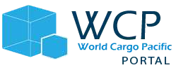
WCP PORTAL
Experience A More Visible Supply Chain

Slide 6
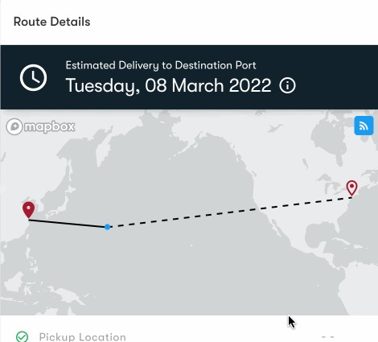
A MODERN DIGITAL EXPERIENCE TO HELP YOU PLAN, MANAGE AND OPTIMIZE YOUR SUPPLY CHAIN.
The Command Center Dashboard is a comprehensive customer platform that provides real-time visibility into all your shipments in a centralized location. With this user-friendly tool, you can easily track and monitor your shipments and containers anytime, seven days a week. It offers a range of features to streamline your shipment management process.
With Live Vessel Tracking, you can stay updated on the progress of your shipments as they travel across the ocean between ports. You receive timely ETAs from the ship's captain, ensuring you have the most accurate information at your fingertips.
Real-Time Visibility
On-Demand Reporting
Automatic Notifications
Personalized Support

Slide 7
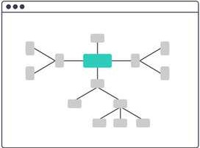
Seamless Customs Declaration
Fast, Smooth Customs Clearance
View documents, status updates, and more to get your goods across the finish line to their final destination.
Alerts & Notifications
Instantly Know Of Status Changes
Never be caught off-guard again, and keep everyone informed with the latest information.
World Cargo Pacific

Slide 8
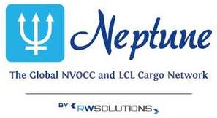
Our Partnerships
World Cargo Pacific

